Slide 1

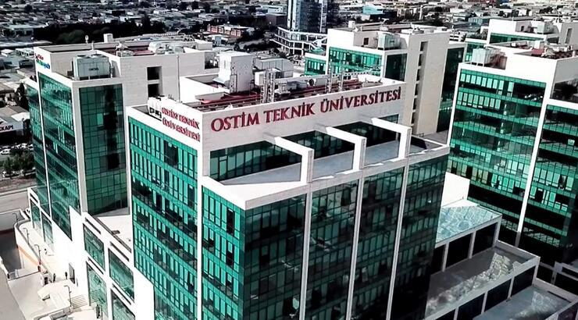
OSTIM Technical University

Slide 2


OSTIM Technical University,
It is a foundation university that began its educational journey in 2019. The university aims to specialize in applied sciences and engineering with education programs integrated with industry. Being located in the OSTIM Organized Industrial Zone, it offers students the opportunity for education and internships closely connected with the industry. The university prepares its students for the future with an education approach focused on entrepreneurship and innovation.

Slide 3

OTUSEM, in addition to offering a wide range of educational services and practical training activities related to various aspects of life, also acts as a solution partner/service provider in areas such as consulting, projects, needs and competency analysis, organization, and more.

Slide 4

Within OSTIM Technical University;
With public and private institutions and organizations training of students and employees needs qualified from academics and industry consisting of professionals with its instructor staff, formal and those who receive online education operates.

Slide 5
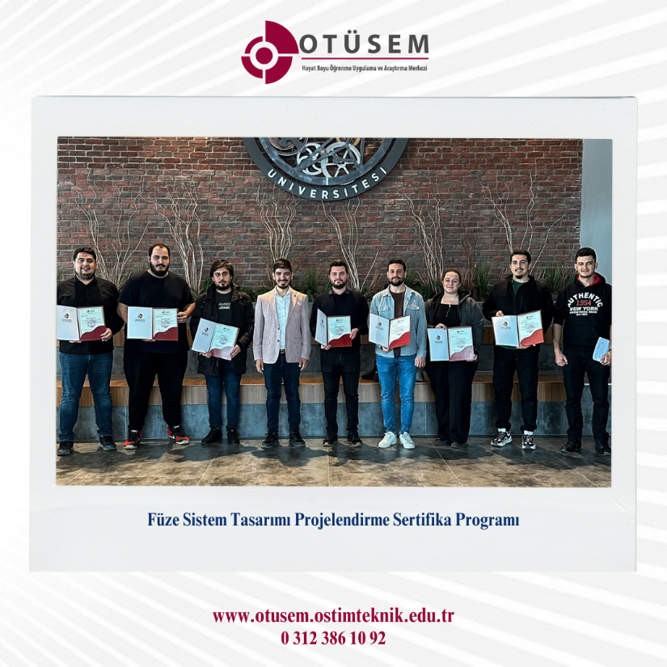
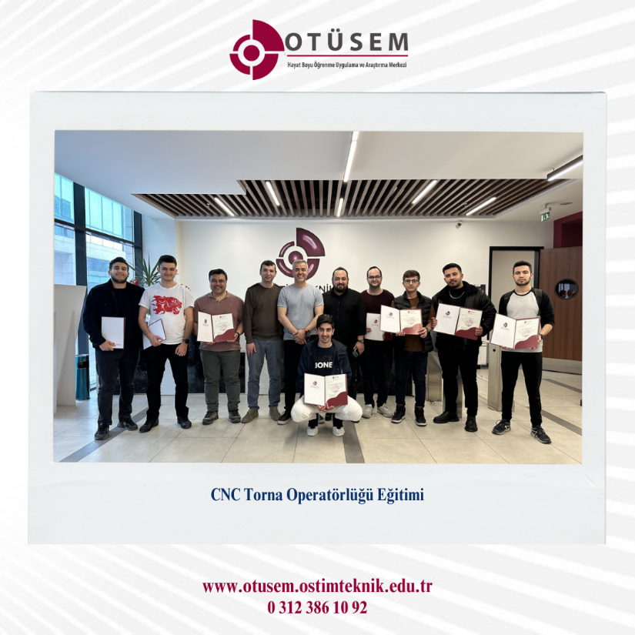
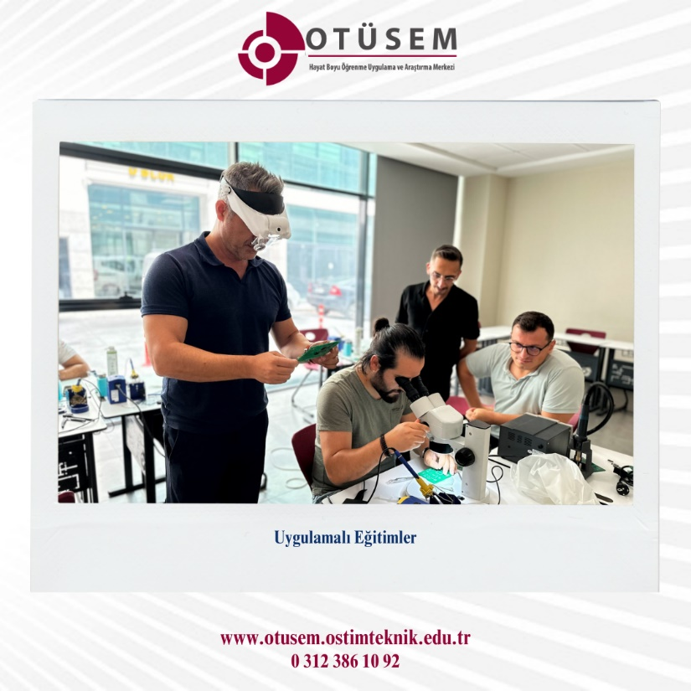
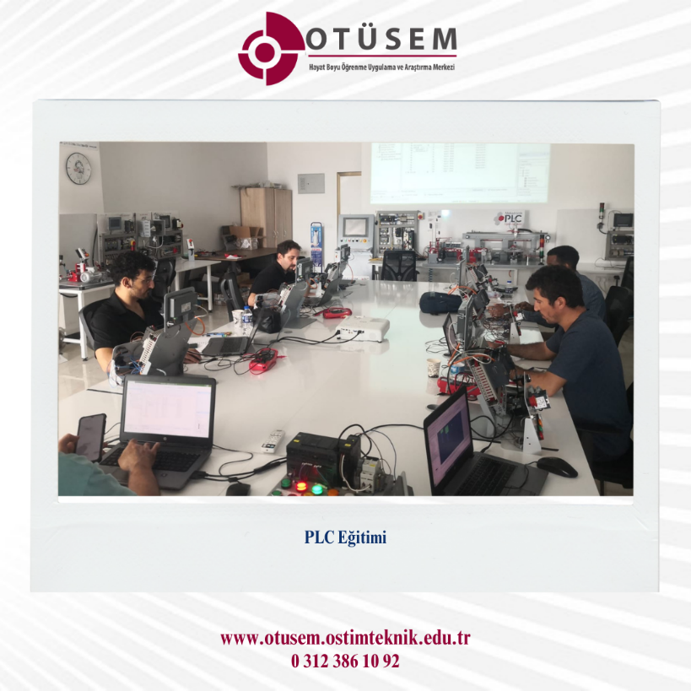
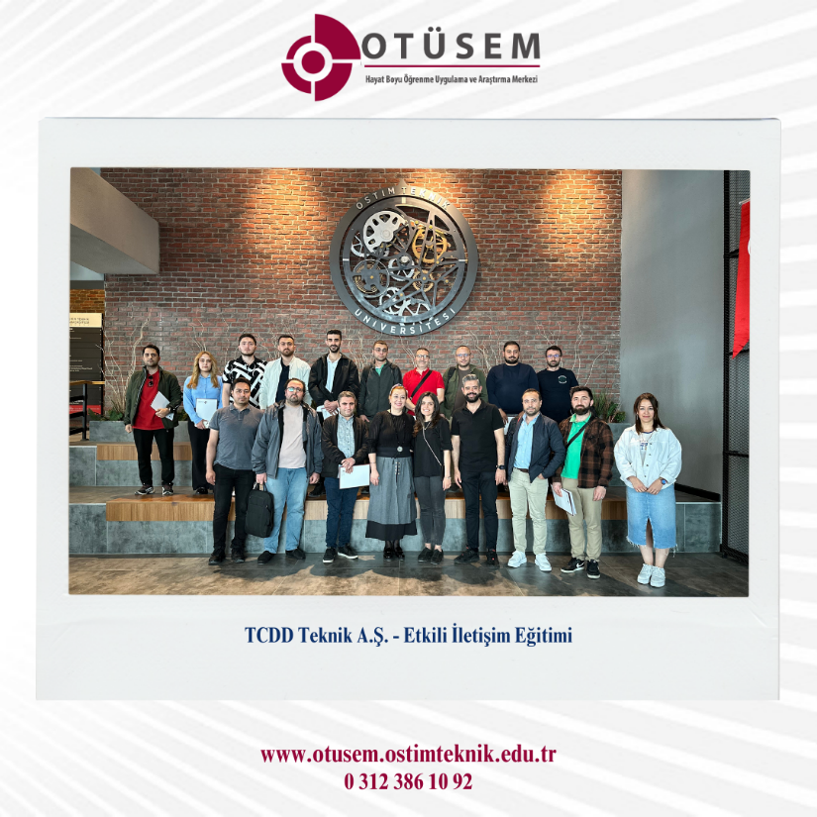
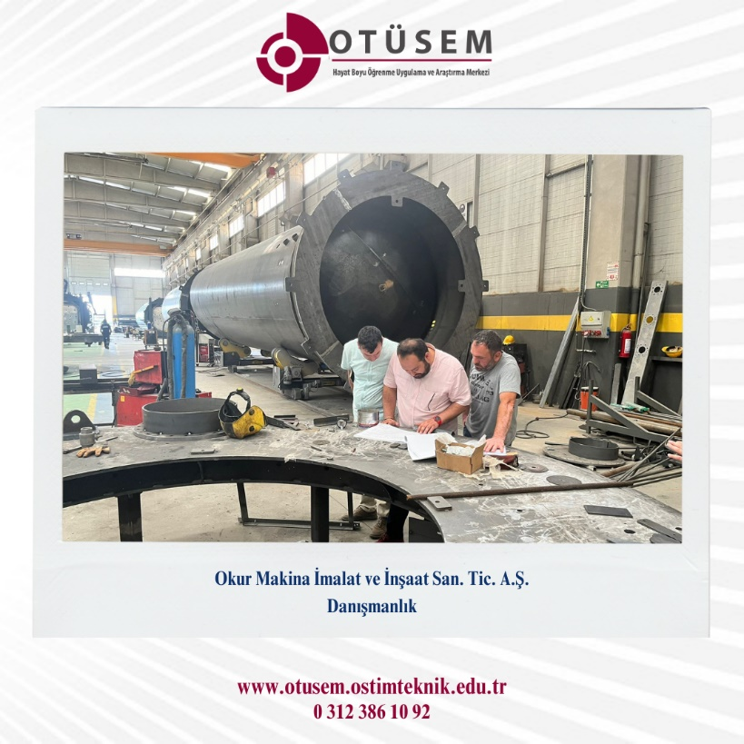

Slide 6
Our fields of activity
Education
Project
Consulting

Slide 7
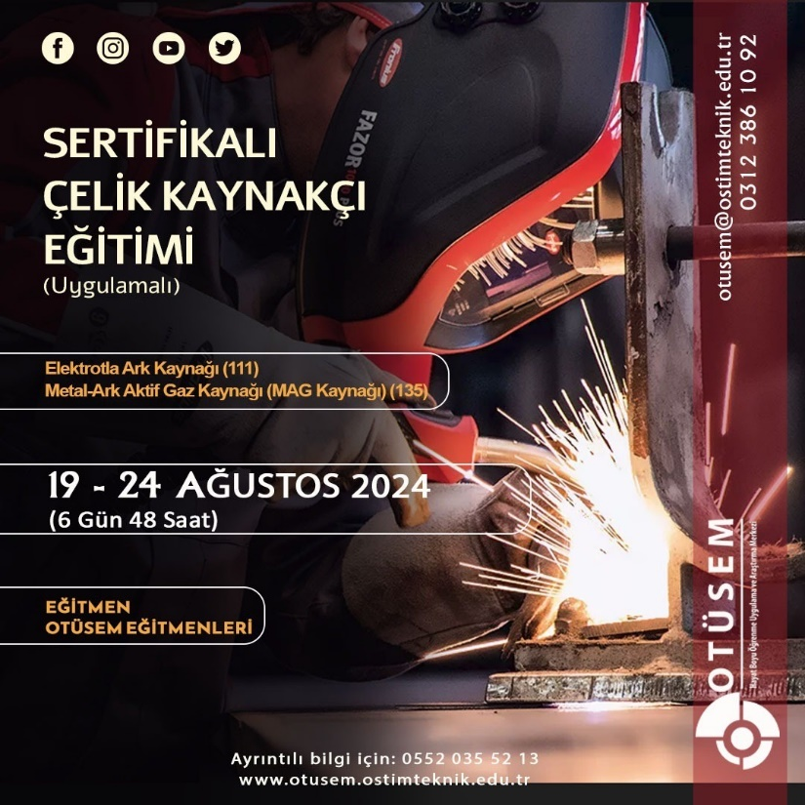


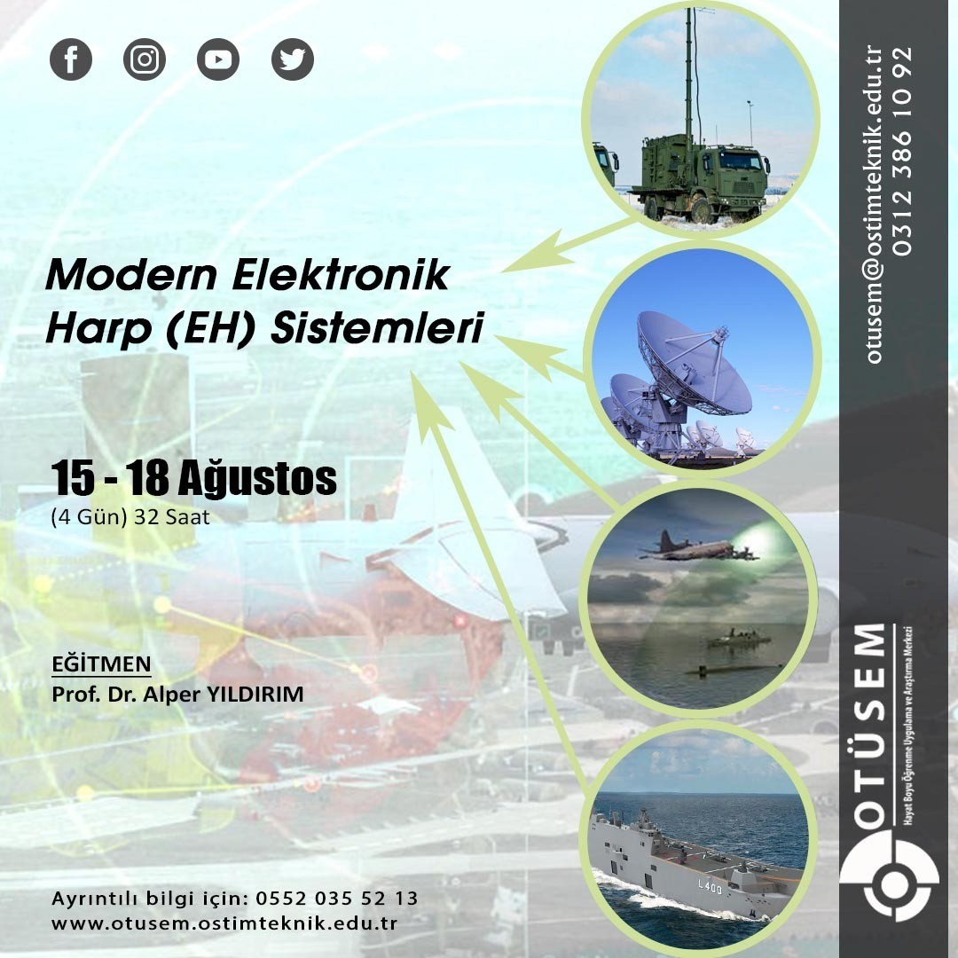



Slide 8
EĞİTİM TALEPLERİ
Training Requests
Individual Requests
Corporate Requests
Individual requests
Individual career planning
Directing you to the right education or profession
Certification
Requests from companies and institutions
Company-Institution Analysis
Content specific to the institution and company
Certification

Slide 9
IT & SOFTWARE &
REPORTING
TRAININGS

Slide 10
INFORMATICS & SOFTWARE & REPORTING TRAININGS
C# Basic Level
C# Advanced Level
C# Programming
Entity Framework
ASP.Net Core
ASP.Net Core Web API
Design Patterns in C#
Bootstrap
Javascript
Typescript
Node.js
React Native
Angular Basic and Advanced

Slide 11
INFORMATICS & SOFTWARE & REPORTING TRAININGS
HTML5 and CSS3 Basic Level
HTML5 and CSS3 Advanced Level
Java Basic Level
Java Advanced Level
Spring Boot
OOP Principles and Design Patterns
Spring MVC
Hibernate
Flutter Basic and Advanced
Android
Android with Kotlin

Slide 12
INFORMATICS & SOFTWARE & REPORTING TRAININGS
Python Basic Level
Python Advanced Level
Machine Learning
Artificial Intelligence
Deep Learning
.NetCore
ASP.Net Core 5 Development
Web API Development with ASP.Net Core
Entity Framework
MySQL
MongoDB
PostgreSQL
Ethical Hacking (CEH)

Slide 13
INFORMATICS & SOFTWARE & REPORTING TRAININGS
Microsoft SQL Server
Querying MS SQL Server
Administering MS SQL Server
Oracle Database
Big Data
Big Query
Windows 10 Training
Sharepoint
Windows Server Networking with Windows Server
System Center Training (SCMM)
System Center 2016

Slide 14
PERSONAL AND
PROFESSIONAL
DEVELOPMENT TRAININGS

Slide 15
PERSONAL AND PROFESSIONAL DEVELOPMENT TRAININGS
PMP
PMI
Project Management Fundamentals
Foreign Trade Expertise
R&D Engineering and Management
Digital Media and Marketing
Photoshop
Industrial Product Design and Development
Protocol and Code of Conduct
Revit
Strategic Brand Management and Digital Marketing

Slide 16
PERSONAL AND PROFESSIONAL DEVELOPMENT TRAININGS
Weapon Maintenance Repair
Small Weapon Ammunition
Defense Industry Introduction Awareness
Defense Industry Resource Management
Model Based Defense System Design
ANSYS
Project Cycle Management
Project Based Hydraulics
Project Based Pneumatics
Cooperative

Slide 17
PERSONAL AND PROFESSIONAL DEVELOPMENT TRAININGS
Effective Communication Techniques
Time Management
Stress Management
Leadership
Methods for Dealing with Difficult People
Negotiation Methods
Meeting Management
Giving Effective Feedback Receiving Feedback
Strengthening Corporate Culture, Belonging, Corporate Citizenship
Anger Management and Professional Behavior

Slide 18
PERSONAL AND PROFESSIONAL DEVELOPMENT TRAININGS
Self-Management-Self-Management Skills, Motivation Techniques
Efficient Working Techniques
Management and Leadership in the New Normal
Problem Solving Techniques
Creating a Strong Corporate Culture, Communication and Corporate Image Management
Agile Leadership
Mentoring
Perception Management
Mind Maps
Speed ​​Reading
Effective Presentation Techniques

Slide 19
PERSONAL AND PROFESSIONAL DEVELOPMENT TRAININGS
Train the Trainer
Coaching
Corporate Representation for Managers
Awareness Raising and Effective Public Speaking
Conflict Resolution Techniques
Delegation

Slide 20
VOCATIONAL TECHNICAL
EDUCATION

Slide 21
VOCATIONAL TECHNICAL TRAININGS
Missile System Design Projecting
CNC Lathe Operation
PLC Automation and Software
Technical Drawing
Modern Electronic Warfare (EW) Systems
Geometric Dimensioning and Tolerancing
Certified Steel Welder
CMM Training
Autocad
3D MAX - VRAY - CORONA
Avionic Systems
Forklift Operator
Electric Stacker Operator

Slide 22
VOCATIONAL TECHNICAL TRAININGS
Hydraulic Maintenance and Troubleshooting
Hydraulic Training Camp
Basic Level Hydraulics
Advanced Level Hydraulics
Safe Working in Confined Areas
Machine Maintainer
Machine Assembler
Solidworks
Pneumatics
Sapancı
Sustainability Basic Concepts and Applications
Radio Controlled Model Aircraft Manufacturing
Electricity and Control

Slide 23
VOCATIONAL TECHNICAL TRAININGS
Overhead Crane Operator
HMI Touch Panel Operator
Manufacturing Techniques with CNC and CAM in the Aviation Industry

Slide 24
QUALITY & SYSTEM
& LAW

Slide 25
QUALITY AND SYSTEM LAW TRAININGS
AS 9102 FAI - First Article Inspection
DIN EN ISO 3834 Welded Manufacturing Inspection
IATF 16949 Automotive Industry Quality Management System
FMEA-APQP-PPAP Training
AS 9100 Basic Training and Internal Auditor Training
ISO 14001 Environmental Management System Basic and Internal Auditor Training
ISO 45001 Occupational Health and Safety Basic and Internal Auditor Training
Actuarial Law and Accounting Principles Training

Slide 26
QUALITY AND SYSTEM LAW TRAININGS
IPC/ WHMA –A620 Wiring Acceptance Criteria Standard
IPC 7711-7721 Electronic Board Assemblies Rework, Repair and Modification Standard
IPC J-STD-001: Soldering Requirements for Electrical and Electronic Board Assemblies
IPC-A 610 Electronic Board Assemblies Acceptance Criteria Standard CIS Training
IPC-A-600 Printed Circuit Boards Acceptance Criteria Standard CIS Training

Slide 27
EUROPEAN PROJECTS
&
GRANT PROGRAMS

Slide 28
EUROPEAN PROJECTS & GRANT PROGRAMS
Project Cycle and Management (PCM) Training – Practical
Erasmus+ Project Cycle and Management (PCM) Training from A to Z – Practical (Specially Designed for Public Institutions.)
Entry Level Erasmus+ School Education and Vocational Education Project Cycle and Management (PCM) Training – Practical
Advanced Level Erasmus+ School Education and Vocational Education Project Cycle and Management (PCM) Training – Practical
Entry Level Erasmus+ Youth Programs Project Cycle and Management (PCM) Training – Practical
Advanced Level Erasmus+ Youth Programs Project Cycle and Management (PCM) Training – Practical

Slide 29
REFERENCES

Slide 30
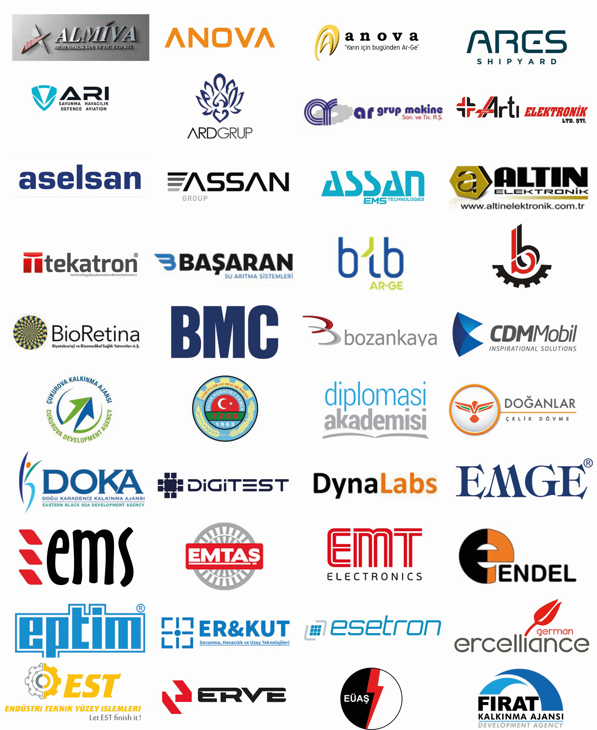

Slide 31
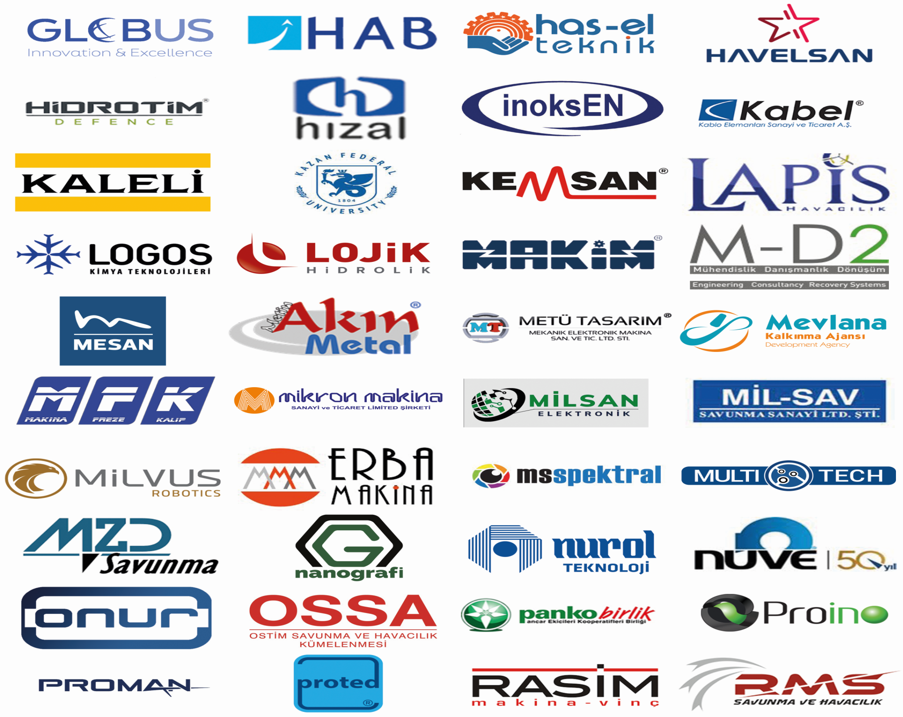

Slide 32
